Slide 1





An Agent-Based Model of Flood Infrastructure Resilience
Richard Dawson
Janetta Steyn, Robin Wardle, Michael Jones, Olivia Butters
richard.dawson@newcastle.ac.uk
@richdawson.bsky.social
richard-dawson-newcastle

Slide 2
Typical assessment of flood risk
Property location (Impact)
Probability of flooding
Flood Risk
(Expected Annual Damages)
Hall, Sayers, Dawson, National-scale Assessment of Current and Future
Flood Risk in England and Wales, https://doi.org/10.1007/s11069-004-4546-7

Slide 3
Flood resilience
Why do some floods generate higher damages or lead to greater loss of life – even in the same location?
Why are some communities ‘back on their feet’ much more quickly?
How do individuals, communities, organisations mediate short term risks and prepare for long term risks are crucial?
What contribution can non-flood defence measures such as warnings, temporary barriers, spatial planning, evacuation make?

Slide 4
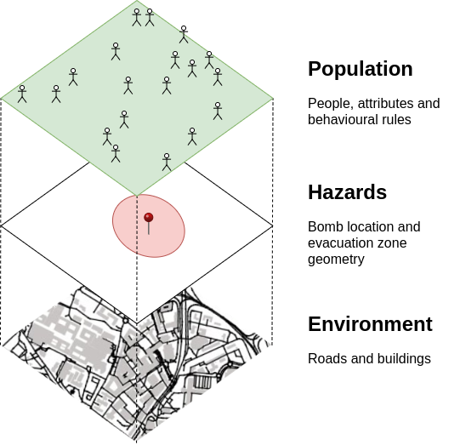
Agent-based modelling
An agent is an entity that functions autonomously in an environment in which other processes and agents exist
Agent-Based Modelling (ABM) combines
  Agents
  An environment
  Description of agent-agent and agent-environment interaction
People, attributes and behavioural rules
Location, attributes and physical properties
Roads, buildings and other features

Slide 5
ABM to capture flood incident responses
Originally developed in NetLogo, now translated into java on DAFNI
People are represented as individual, autonomous agents
Hazard simulated using a 2D hydrodynamic model
At each time step, agents select their next action based on the current state of the system, environment constraints, and a predefined ruleset
People, attributes and behavioural rules
Location, attributes and physical properties
Roads, buildings and other features

Slide 6
ABM to capture flood incident responses
Spatial data:
  Flood defences
Ground elevation
Transport network
Property type and location
etc.
Behaviour rules:
  Normal interaction
Response to warning
Response to floodwater
etc.
Resilience actions:
  Evacuation strategy
Flood warning etc.
ABM Environment
Hydrodynamic simulation
Agent simulation
Event conditions:
  Storm surge
Failed defence
Time of day etc.
Vulnerability information:
  Economic
Drowning
etc.
Risk analysis

Slide 7
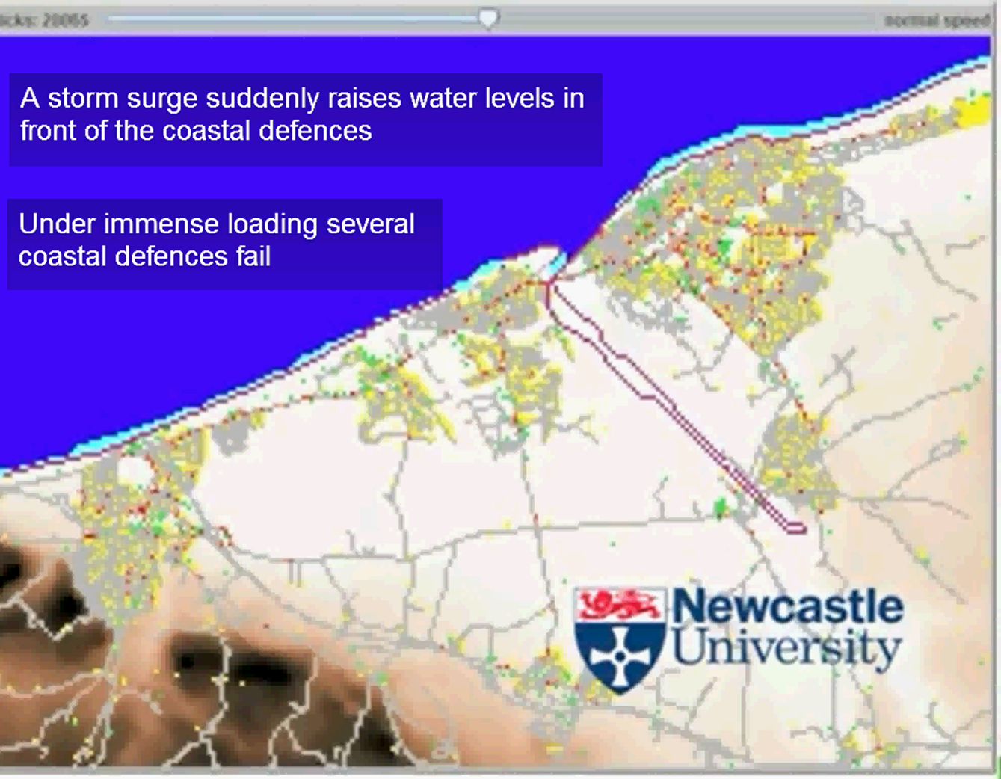
http://www.youtube.com/watch?v=o0EOlc5n9O8
Dawson, R. J., Peppe, R. and Wang, M. An agent based model for risk-based flood incident management, Natural Hazards, doi: 10.1007/s11069-011-9745-4

Slide 8
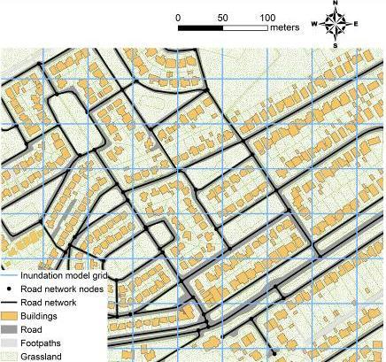
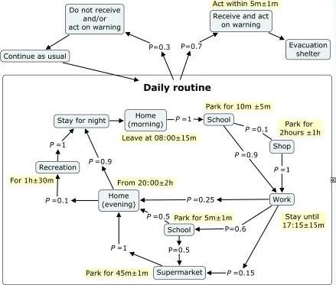
Geospatial behaviour model for different demographic and agent types

Slide 9
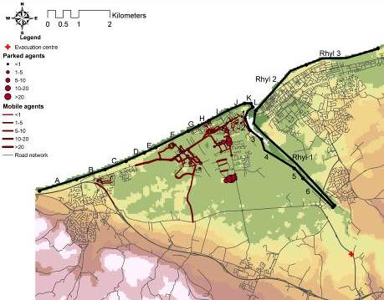
Spatial impacts: Single defence breach
Breach location

Slide 10
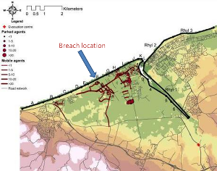
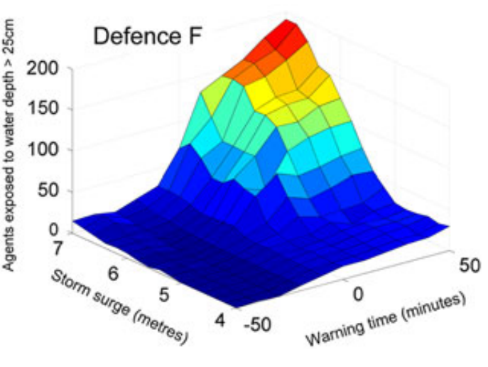
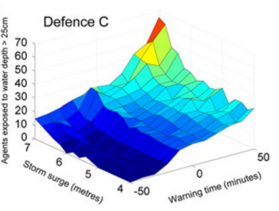
Vulnerability
Defence F
Defence C

Slide 11
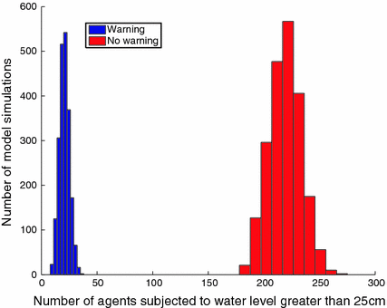
Effectiveness of flood warning
2173 simulations with / without flood warning
All agents respond to warning immediately
Alter random seed
Different variance
Notes:
From >2000 simulations each – changing random seed

Slide 12
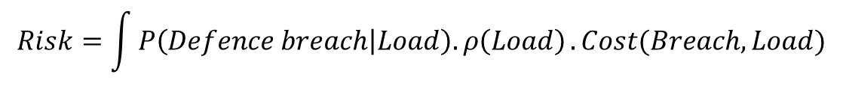
Risk to people vs. property
$$Risk=\int{P\left(Defence breach | Load\right).ρ\left(Load\right)}.Cost(Breach,Load)$$
Rank | Population | Economic
1 | I | B
2 | H | C
3 | J | E
DEFRA & Environment Agency, Risk Assessment for Flood and Coastal Defence for Strategic Planning, R&D TECHNICAL REPORT: W5B-030/TR
Notes:
Combination of probability of defence failure; loading; impacts

Slide 13
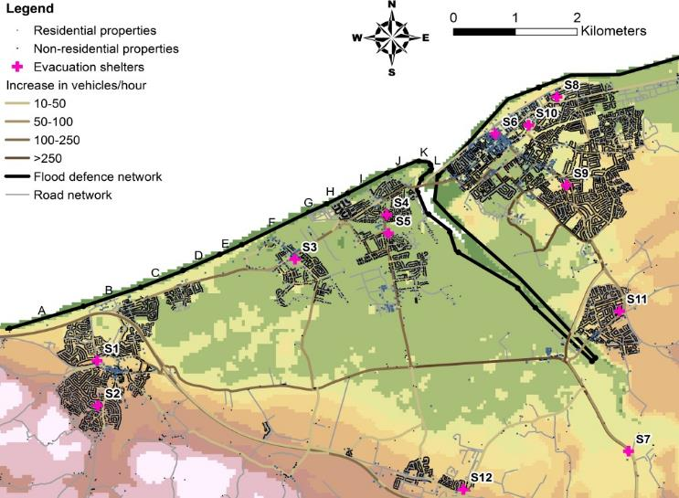
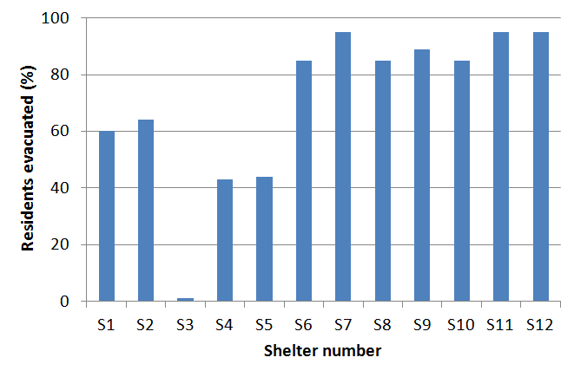
Evacuation location
Breach location

Slide 14
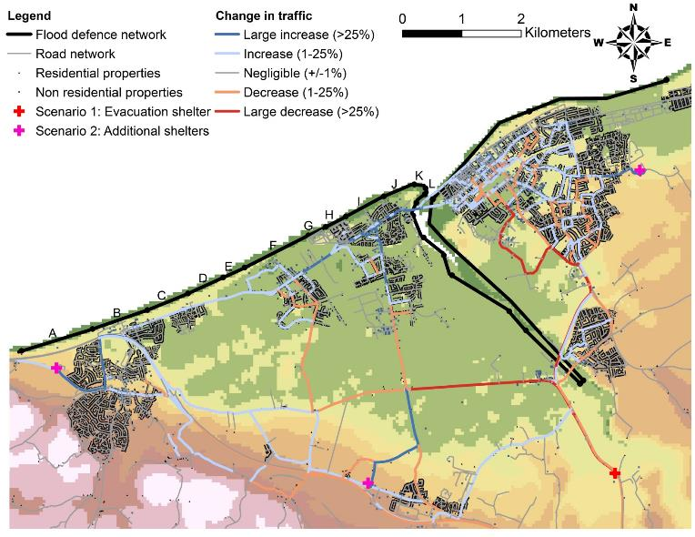
Congestion
Breach location

Slide 15
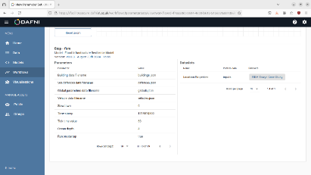
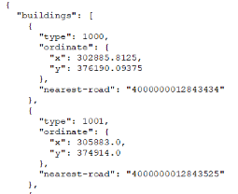
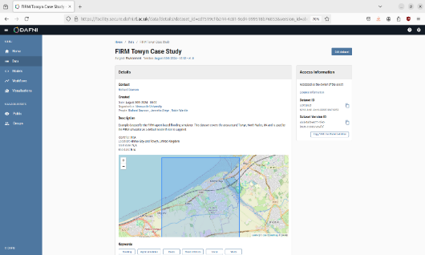
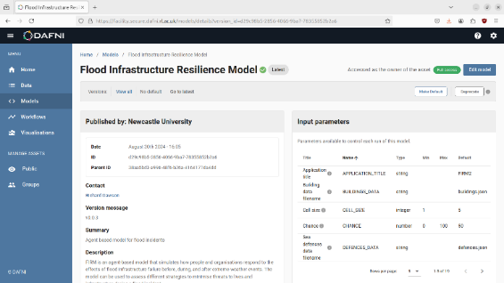

Centre of Excellence project
NetLogo code now in java
Model workflow in DAFNI
Standardised input data (*.json)
Example datastet (Towyn, N. Wales)
Instructions

Slide 16
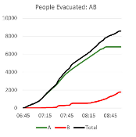
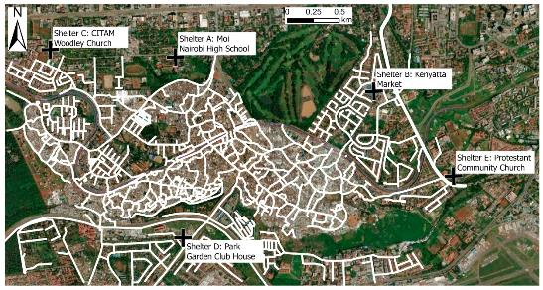
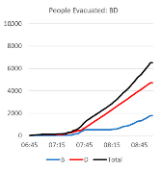
Open data application: Kibera
People / m road length
Butters & Dawson, Flood Evacuation in Informal Settlements: Application of an Agent-Based Model to Kibera Using Open Data, https://doi.org/10.3390/urbansci9010012

Slide 17
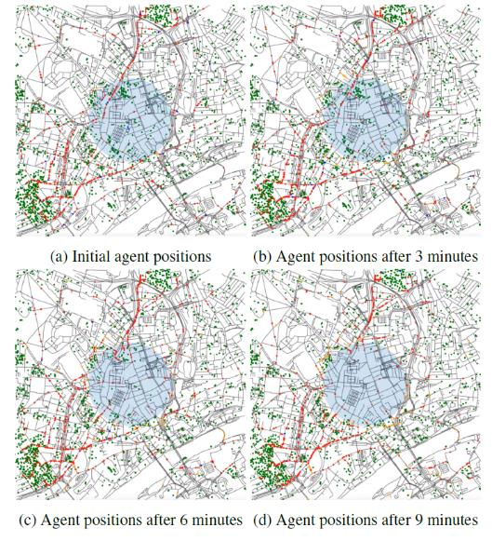
Alternative hazards
Jones et al. in 20th European Social Simulation Conference

Slide 18
Conclusions
ABM enables consideration of how human behaviour and response alters flood incident outcomes
  Spatial structure and attributes of people/activities, hazard, and transport network all influence risk
  Identify emergent phenomena such as routes congested under multiple situations
Consideration of social risks can alter investment priorities
Uncertainties inevitable – but assumptions can be made transparent and explored. Opportunities to improve this emerging from non-traditional data and AI
DAFNI Centre for Excellent project has laid foundations for wider case studies, new developments and integration with other DAFNI models

Slide 19
An Agent-Based Model of Flood Infrastructure Resilience
Richard Dawson
Janetta Steyn, Robin Wardle, Michael Jones, Olivia Butters
richard.dawson@newcastle.ac.uk
@richdawson.bsky.social
richard-dawson-newcastle

